Slide 1
Device-agnostic definition

Slide 2
Device-agnostic design, also known as responsive or adaptive design, refers to the approach of creating digital content or applications that can adapt and function effectively across various devices, screen sizes, and resolutions without sacrificing user experience. The goal is to ensure that users have a consistent and optimized experience regardless of whether they are accessing the content on a desktop computer, laptop, tablet, smartphone, or any other internet-enabled device.

Slide 3
Key principles of device-agnostic design include:
Fluid Layouts: Designing layouts that can adjust and resize fluidly based on the screen size and resolution of the device being used.
Flexible Images and Media: Using scalable images and media that can adapt to different screen sizes without losing quality or breaking the layout.
Responsive Typography: Employing font sizes and styles that are readable and legible across different devices and screen sizes.
Progressive Enhancement: Providing a baseline experience that works across all devices and then progressively enhancing it with additional features or optimizations for more capable devices.

Slide 4
5.Mobile-First Approach: Designing the user experience starting from the smallest screen size (e.g., smartphones) and then scaling up for larger screens, ensuring a strong foundation for all devices.
6.Performance Optimization: Optimizing the performance of the website or application to ensure fast loading times and smooth interactions across various devices and network conditions.
7.Accessibility Considerations: Ensuring that the design is accessible to users with disabilities and compatible with assistive technologies across different devices.
By adopting device-agnostic design principles, developers can create more inclusive and user-friendly digital experiences that cater to the diverse range of devices and technologies used by audiences today. This approach also future-proofs the design, making it easier to adapt to new devices and screen sizes as they emerge.

Slide 5
Device agnostic is the ability of software or applications to work seamlessly across various devices, regardless of its make, model, operating system, or other characteristics. The primary goal is to provide a consistent user experience and functionality regardless of the hardware used to access the content or application.

Slide 6
How device-agnosticism works
Device-agnostic design often relies on responsive or adaptive design principles. For example, a device-agnostic website will adjust its layout and elements based on the screen size, resolution, and capabilities of the device accessing it, be it a smartphone, tablet, desktop, or smart TV.

Slide 7
Device-agnostic advantages
Ensures that content or applications are accessible to a broader audience, regardless of their device.
No need for developing and maintaining multiple versions of an application for different
A consistent and uniform user experience builds brand reliability and trust.
Future-proofs content or applications, preparing them for emerging devices and technologies.

Slide 8
Device-agnostic disadvantages
Creating a one-size-fits-all solution can be complex and require compromises in design elements.
Ensuring optimal performance across all devices can be challenging.
Requires extensive testing across various devices to ensure compatibility and consistency.

Slide 9
How to design responsive and device-agnostic forms
Whether it is a signup flow or a multi-view stepper, forms are one of the most important components of digital product design – so you need to design them so they work effectively on mobile devices.
Here's how to design forms for mobile devices, including a quick look at how to use Flexbox.

Slide 10
Design for vertical scroll
Regardless of the device size, the easiest way to complete a form is in a linear fashion. Multiple columns disrupt a user's momentum (the users are likely to interpret the fields inconsistently, which is a negative factor in terms of usability) and can result in users having to resort to horizontal scrolling. When it comes to laying out forms, you should design the entries in one column: if a form is in a single column, the path to completion is a straight line down the page.

Slide 11
Place labels above fields
Labels tell users what the corresponding input fields mean. When choosing where to place your labels you have two options: left-aligned or top-aligned.
Left-aligned labels work well if the form is being completed on a desktop or tablet. However, they are an awful solution for mobile devices where there is limited screen estate. Since left-aligned labels need to sit before the field, the narrow screen leaves very little space for the field itself – especially if the device is in portrait mode. This creates two serious usability issues:
The form field won't be wide enough to display the user's entire input, making them more likely to mistype their responses and leading to more erroneous forms being submitted
When a user is notified that they have entered erroneous information, they may have a hard time spotting and fixing the problem as they won't be able to see the entire invalid input
Placing the label above the form field when a user is browsing from a mobile device will ensure users can see the maximum width to input their details, since you don't need to use up any for the label.
Writing your labels above the input fields also makes it much easier for you to write clear and meaningful field labels, as you won't be limited to one or two words.

Slide 12
Use tap targets
Tap targets should be easy to use no matter what size of device they are displayed on. Larger targets (input fields and buttons) are easier for users with lower dexterity, whether that is a permanent condition or a temporary one caused by the environment.
At the moment, the largest target size is for touch devices, so you need to design touch-first. This ensures users won't have to zoom in to enter the text or select an option. Clickable areas should follow the fat finger rule and not encroach on surrounding areas: the average human finger pad is 10 x 14mm and the average fingertip is 8-10mm, making 10 x 10mm a good minimum touch target size.
But not only should a tap target be properly sized, you should also ensure there is enough space between multiple tap targets. In fact, if you are getting the 'Tap target size' error on mobile SEO tools, it is often because your tap targets are too close together, rather than the actual tap target being too small.
It can be tough to read content on mobile devices, so making the inputs 100% and ensuring the text is set to at least 16px (1em) will make a big difference. That way, no pinch zooming or extra scroll will be required to read the required information.

Slide 13
Use HTML5 form fields
Mobile devices offer custom software keyboards for different input types, and HTML5 form fields are the single easiest way to improve the user experience of your forms. These input types give hints to the browser about what type of keyboard layout to display for on-screen keyboards.
Include the input types of number, email, tel, url and date, and the keyboard input on your mobile devices will update to make it easier for the user to filling in the form. It does not require you to add extra classes to style form inputs, all you need to do is to use valid HTML5 input types:
<input type="email" id="input-email">

Slide 14
Use Flexbox
Our Web designer's guide to Flexbox article tells you more, but for now let's do some practice and learn how to take advantage of Flexbox to create a responsive form. First things first, let's define the HTML structure for our form:
<form>
<ul class="flex">
<li><label for="first-name">First Name</label><input type="text" id="first-name" placeholder="Enter your first name here"></li>
<li><label for="last-name">Last Name</label><input type="text" id="last-name" placeholder="Enter your last name here"></li>
<li><label for="email">Email</label><input type="email" id="email" placeholder="Enter your email here"></li>
<li><label for="phone">Phone</label><input type="tel" id="phone" placeholder="Enter your phone here"></li>
<li><label for="message">Message</label><textarea rows="6" id="message" placeholder="Enter your message here"></textarea></li>
<li><button type="submit">Submit</button></li>
</ul>
</form>

Slide 15
Let's identify the flex containers in our CSS. Additionally, we want to vertically centre the flex items across the cross-axis. It's pretty easy to specify that, we just need to set up a simple CSS rule:
.flex li {
display: flex;
flex-wrap: wrap;
align-items: center;
}

Slide 16
The next step is to specify the widths for the flex items. The main requirements:
Labels should be at least 100px and at most 200px
Form elements that come after the labels should be at least 200px
What does this give us? Each label and its associated form element will be displayed on a single horizontal row when the width of the form totals at least 300px (remember, we're using right-aligned labels here).
.flex > li > label {
flex: 1 0 100px;
max-width: 200px;
}
.flex > li > label + * {
flex: 1 0 200px;
}
In CSS, the greater than symbol (>) is used as a child combinator selector. It is used to select an element that is a direct child of another element.
The + symbol is used as an adjacent sibling combinator. It selects an element that is immediately preceded by a sibling element. For example:
The * symbol, on its own, is a wildcard selector. It selects all elements

Slide 17
Lastly, for the submit button, which is also a flex item, we define a few basic styles:
.flex li button {
margin: auto;
padding: 22px 46px;
}

Slide 18

Here's an example of HTML code implementing device-agnostic design principles using basic responsive techniques like fluid layouts and media queries:
<!DOCTYPE html>
<html lang="en">
<head>
<meta charset="UTF-8">
<meta name="viewport" content="width=device-width, initial-scale=1.0">
<title>Device-Agnostic Design</title>
<style>
/* Base styles */
body {
font-family: Arial, sans-serif;
margin: 0;
padding: 0;
}
.container {
width: 90%; /* Set a fluid width */
max-width: 1200px; /* Set a maximum width */
margin: 0 auto; /* Center the container */
padding: 20px;
}
/* Responsive styles */
@media screen and (max-width: 768px) {
.container {
width: 100%; /* Adjust width for smaller screens */
}
}
</style>
</head>
<body>
<div class="container">
<h1>Welcome to Device-Agnostic Design</h1>
<p>This is an example of HTML code demonstrating device-agnostic design principles.</p>
<p>The content within this container will adapt its width based on the screen size of the device.</p>
</div>
</body>
</html>
In this code:
The viewport meta tag ensures proper scaling on different devices.
The .container class sets a fluid width with a maximum width of 1200 pixels and centers it on the page.
The @media rule defines styles that apply when the screen width is 768 pixels or less, adjusting the container width to 100% to make it full-width on smaller screens.
This example provides a basic structure for a device-agnostic design. You can further enhance it with additional CSS styles and media queries to make your website more responsive and adaptable across a wider range of devices.

Slide 19
Creating a device-agnostic design that prioritizes mobile devices often involves starting with a mobile-first approach. Below is an example of HTML code demonstrating a simple mobile-first design:
<!DOCTYPE html>
<html lang="en">
<head>
<meta charset="UTF-8">
<meta name="viewport" content="width=device-width, initial-scale=1.0">
<title>Device-Agnostic Design</title>
<style>
/* Base styles */
body {
font-family: Arial, sans-serif;
margin: 0;
padding: 0;
background-color: #f0f0f0;
}
.container {
padding: 20px;
background-color: #fff;
border-radius: 10px;
box-shadow: 0 0 10px rgba(0, 0, 0, 0.1);
margin: 20px auto;
max-width: 400px;
}
h1 {
font-size: 24px;
margin-top: 0;
}
p {
font-size: 16px;
line-height: 1.5;
}
</style>
</head>
<body>
<div class="container">
<h1>Welcome to Mobile-First Design</h1>
<p>This is an example of HTML code demonstrating a mobile-first approach to device-agnostic design.</p>
<p>The content within this container is optimized for mobile devices and will adapt to larger screens as well.</p>
</div>
</body>
</html>

Slide 20
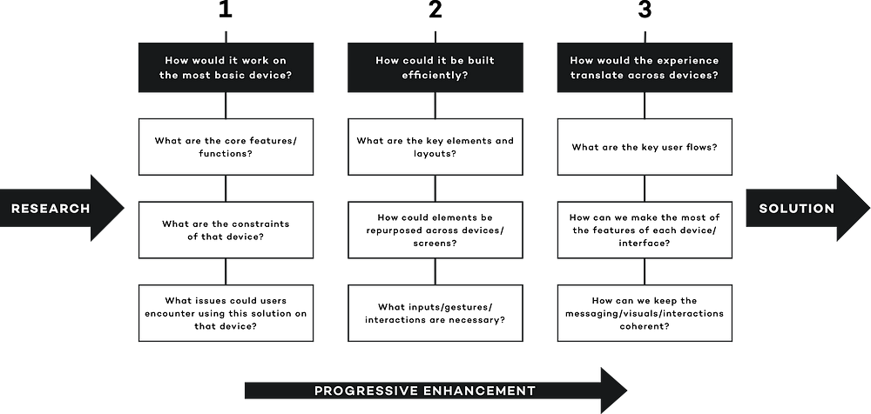

Slide 21
How would the experience translate across devices?
Try and think of all the different ways a user could interact with your solution. Take the Nest thermostat, for example, a user could ask their voice assistant to turn the heat up, maybe they go out and proceed to turn the heating off remotely from their smartphone and once they’re back home could set up a heating schedule for their upcoming holiday on a tablet.
Each device has benefits and limitations. A voice assistant requires no haptic interaction but gives little in the way of visual feedback, a smartphone is most likely with you at all times and useful for notifications but the smaller screen may be limiting for more complex tasks. How can you take advantage of each device/interface to enhance the experience for the user?
How can you keep the experience coherent? Will the prompts on the voice assistant have the same tone of voice as the messaging on the smartphone app, will the gestures be the same on a smartwatch as a tablet? Make sure you consider the overarching experience a user will have regardless of what device they are using, will it still feel like your product/brand?

